Slide 1

Schematron Tutorial
Declarative Amsterdam
November 7 and 8, 2022
While waiting, maybe you can do some preparations?
Go to https://da2022.xatapult.com for instructions!

Slide 2

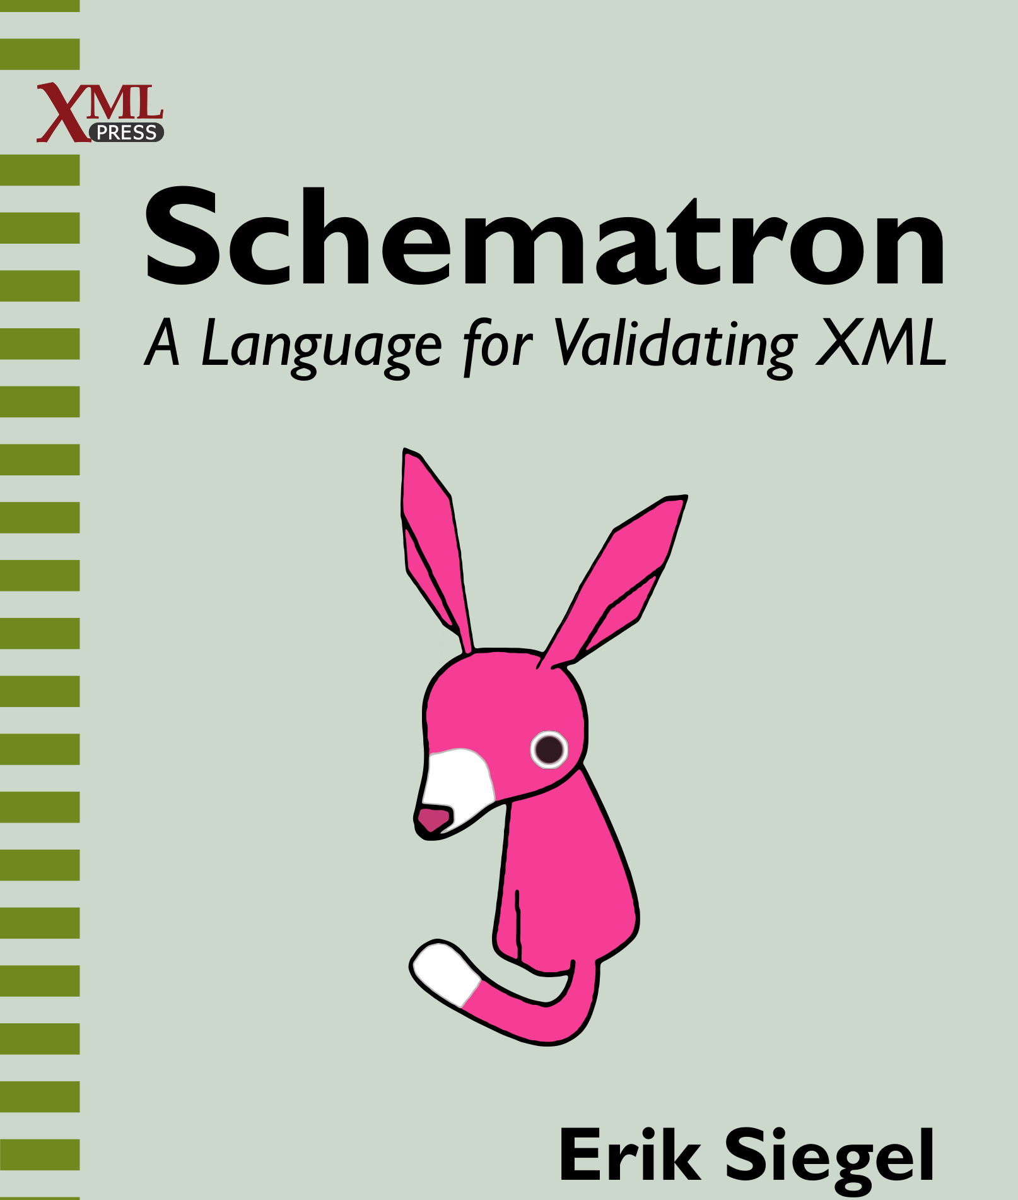
Who Am I?
Erik Siegel
Content Engineer and XML specialist
One-man company: Xatapult
Groningen, The Netherlands
Author of "Schematron – A language for validating XML"
Contact:
erik@xatapult.nl www.xatapult.com www.linkedin.com/in/esiegel/ +31 6 53260792

Slide 3

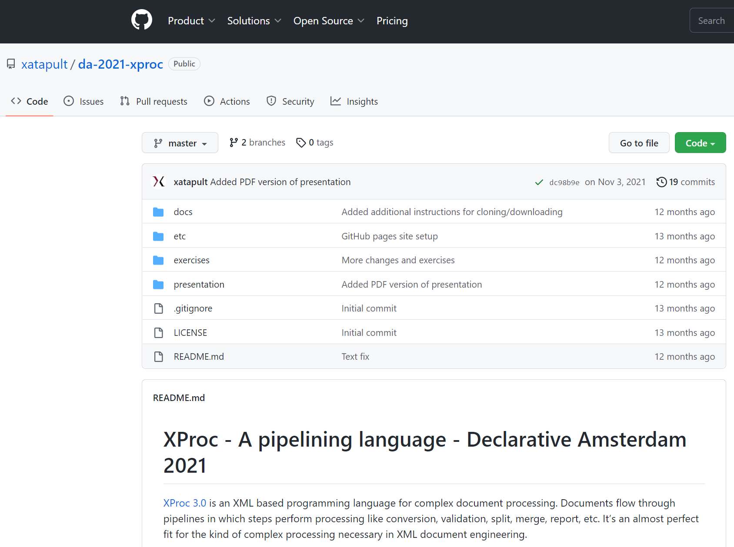
Tutorial format
Bit of theory
Exercise!
Basic instructions: http://da2022.xatapul t.com/
Presentation, code and instructions: https://github.com/xatapult/da-2022-schematron
Easiest to follow using oXygen, all prepared
All exercises contain instructions in instructions.pdf
Solution and explanations in solution/ subfolder
Repeat
All instructions and explanations are collected in exercises/syllabus.pdf

Slide 4

Schematron highlights
A formal XML based schema language
Simple but powerful
Can go way beyond the "classic" validation languages
Two types of rules:
Assertions
Reports
Messages in your own words!
XPath based expressions
Incorporates XSLT keys and functions
Has a predefined XML based output format (SVRL)
I'm the Schematroll
I'm Schematron's logo!

Slide 5
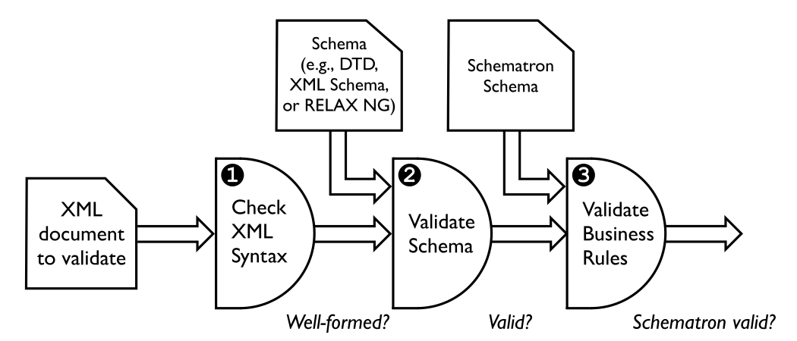
Schematron in context

Slide 6

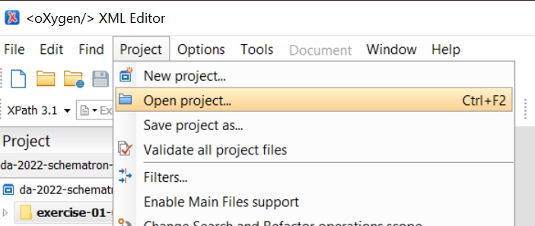
Hands-on: Installation and pre-flight check #1
Done all preparations?
Download/cloned the GitHub repository for this tutorial? https://github.com/xatapult/da-2022-schematron
A Schematron processor ready? Preferably oXygen…
When using oXygen:
Open the oXygen project: …/exercises/da-2022-schematron-exercises.xpr

Slide 7
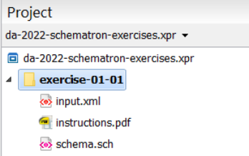

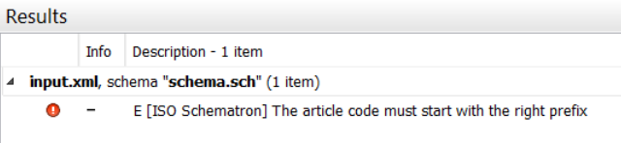
Hands-on: Installation and pre-flight check #2
When using oXygen:
Open the file …/exercises/exercise-01-01/input.xml:
Validate it by pressing the button on the toolbar
Or by using the menu option Document > Validate > Validate
Or by pressing ctrl-shift-V
You should see:
Have a look at schema.sch, the Schematron schema used

Slide 8
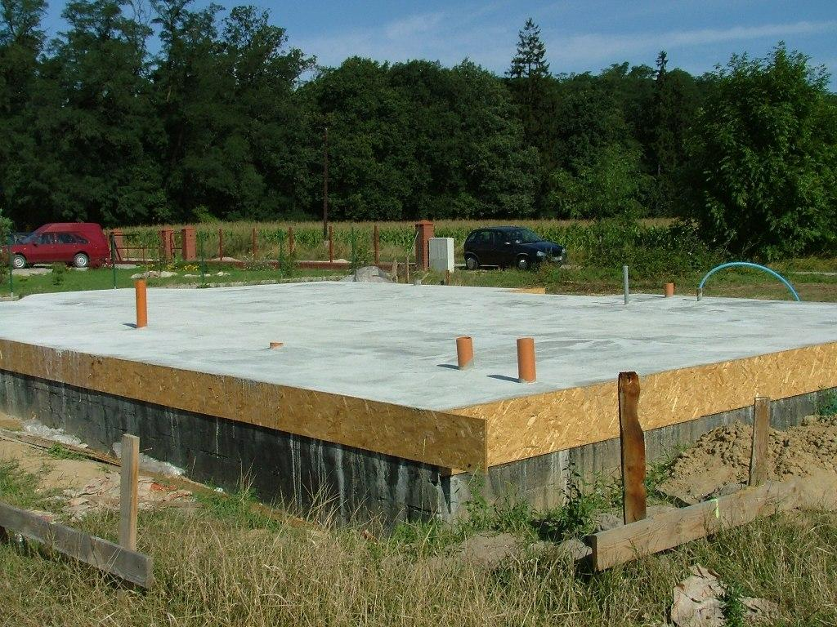
Schematron fundamentals

Slide 9
An empty Schematron schema
<schema xmlns="http://purl.oclc.org/dsdl/Schematron" queryBinding="xslt3">
<pattern>
</pattern>
</schema>

Slide 10
Patterns and rules
A Schematron schema consists of one or more patterns: <pattern>
Every pattern is applied to every node in the document being validated
A pattern consists of zero or more rules: <rule context="…">
A rule has a context attribute, containing an XSLT match pattern
Only the first rule that matches in a pattern fires
<schema xmlns=http://purl.oclc.org/dsdl/Schematron queryBinding="xslt3">
<pattern>
<rule context="thing[@material eq 'wood']"> … </rule>
<rule context="thing"> … </rule>
</pattern>
</schema>

Slide 11
Assertions and reports
When a rule fires, the node fired upon becomes the context item
A rule consists of zero or more
asserts: <assert test="…"> - Activated when the test expression is false
reports <report test="…"> - Activated when the test expression is true
The contents of the element is issued as validation message
<thing code="T12345" price="75.25"/>
<rule context="thing">
<assert test="starts-with(@code, 'T')">Codes must start with a T</assert>
<report test="xs:double(@price) gt 100">High priced thing found!</report>
</rule>

Slide 12
Hands-on: Assertions and reports
All files in: …/exercises/exercise-02-01
Read the instructions in: instructions.pdf
Open the files:
Document to validate: input.xml
Template Schematron schema: template.sch
Fill in template.sch according to the instructions
To try it out in oXygen, input.xml is automatically validated by template.sch
Possible solution in: solution/solution.sch (short explanation in solution/explanation.pdf).

Slide 13

Rule processing revisited
Assume we have an XML document with <book> and <magazine> elements, underneath some root element
We have specific rules for books and magazines, but also rules that apply to all elements
Will this work?
<pattern>
<rule context="/*/book">
… (asserts and reports for book elements)
</rule>
<rule context="/*/magazine">
… (asserts and reports for magazine elements)
</rule>
<rule context="/*/*">
… (asserts and reports for all elements)
</rule>
</pattern>

Slide 14
Hands-on: rule processing
All files in: …/exercises/exercise-02-02
Read the instructions in: instructions.pdf
Open the files:
Document to validate: input.xml
Template Schematron schema: template.sch
Improve in template.sch according to the instructions
To try it out in oXygen, input.xml is automatically validated by template.sch
Possible solution in: solution/solution.sch (short explanation in solution/explanation.pdf).

Slide 15
What's the result of a Schematron validation?
Schematron has an XML reporting language called SVRL: Schematron Validation Reporting Language
In an IDE like oXygen, you don't see it
Using the command line, you will
Useful in toolchains and automated processing
For instance, create a custom report

Slide 16
SVRL example
<schematron-output xmlns="http://purl.oclc.org/dsdl/svrl">
<active-pattern documents="…/parcels-schematron-invalid.xml"/>
<fired-rule context="/*"/>
<failed-assert location="/Q{}parcels[1]" test="…">
<text>The total weight is too high</text>
</failed-assert>
<active-pattern documents="…/parcels-schematron-invalid.xml"/>
<fired-rule context="parcel"/>
<successful-report location="/Q{}parcels[1]/Q{}parcel[1]" test="…">
<text>The parcel's date must be more than 10 days before the delivery date</text>
</successful-report>
<fired-rule context="parcel"/>
</schematron-output>

Slide 17
More meaningful messages: <value-of>
The <value-of select="…"/> element allows you to add values from the validated document to your messages
<rule context="/*/*">
<assert test="string-length(@code) eq 4">A code must be 4 characters long</assert>
</rule>
<rule context="/*/*">
<assert test="string-length(@code) eq 4">
The code <value-of select="@code"/> is invalid. It must be 4 characters long.
</assert>
</rule>

Slide 18
Hands-on: better messages
All files in: …/exercises/exercise-02-03
Read the instructions in: instructions.pdf
Open the files:
Document to validate: input.xml
Template Schematron schema: template.sch
Enhance template.sch according to the instructions
To try it out in oXygen, input.xml is automatically validated by template.sch
Possible solution in: solution/solution.sch (short explanation in solution/explanation.pdf).
Solution for the additional changes in: solution/solution-extended.sch

Slide 19
Variables: <let>
Declare a variable using the <let> element: <let name="code-value" value="@code"/>
Allowed as children of:
<schema> (context item document node)
<pattern> (context item document node)
<rule> (context item node matched upon)
Reference it (like in XSLT) with a $ prefix: <assert test="$code-value eq 'IMPORTANT'"> <value-of select="$code-value"/>

Slide 20
Hands-on: variable usage
All files in: …/exercises/exercise-02-04
Read the instructions in: instructions.pdf
Open the files:
Document to validate: input.xml
Template Schematron schema: template.sch
Enhance template.sch according to the instructions
To try it out in oXygen, input.xml is automatically validated by template.sch
Possible solution in: solution/solution.sch (short explanation in solution/explanation.pdf).

Slide 21

Declaring namespaces: <ns>
Namespaces for expressions must be declared with <ns> elements: <ns uri="http://www.w3.org/1999/xhtml" prefix="xh"/>
The "normal" XML way of declaring namespaces will not work for expressions: <schema … xmlns:xh="http://www.w3.org/1999/xhtml">

Slide 22
Hands-on: Declaring and using a namespace
All files in: …/exercises/exercise-02-05
Read the instructions in: instructions.pdf
Open the files:
Document to validate: input.xml
Template Schematron schema: template.sch
Write template.sch according to the instructions
To try it out in oXygen, input.xml is automatically validated by template.sch
Possible solution in: solution/solution.sch (short explanation in solution/explanation.pdf).

Slide 23

Basic Schematron: Wrap-up
Root element <schema> with namespace http://purl.oclc.org/dsdl/schematron
A Schematron schema consists of:
<pattern> (checked for all nodes in the document)
<rule> (only the first on that matches fires)
<assert test="…">
<report test="…">
Enhance the messages using <value-of select="…"> elements
Create variables using <let name="…" value="…"> elements
Define a namespace using <ns uri="…" prefix="…"> elements

Slide 24

Abstract patterns
Phases
Diagnostics

Slide 25
Abstract pattern fundamentals
Abstract patterns are macros
Parameters alter their instantiations
<pattern abstract="true" id="id-of-abstract-pattern">
…
</pattern>
<pattern is-a="id-of-abstract-pattern">
<param name="some-parameter" value="some text"/>
</pattern>

Slide 26
Abstract pattern input example
<tables>
<!-- HTML table: -->
<table>
<tr>
<td>Yes!</td>
<td>No!</td>
</tr>
</table>
<!-- Calendar table-like structure: -->
<year>
<week>
<day>Monday</day>
<day>Tuesday</day>
<!-- Etc. -->
</week>
</year>
</tables>

Slide 27
Abstract pattern example
<pattern abstract="true" id="table-pattern">
<rule context="$table">
<assert test="$row">
The element <value-of select="local-name()"/> is a table structure.
Tables must contain the correct row elements.
</assert>
</rule>
<rule context="$table/$row">
<assert test="$entry">
The element <value-of select="local-name()"/> is a table row.
Rows must contain the correct cell elements.
</assert>
</rule>
</pattern>
Abstract pattern parameters share the $... syntax with variables
Will be replaced with text
Abstract pattern parameters are not declared in any way

Slide 28
Abstract pattern instantiation example
<!-- Pattern for HTML tables: -->
<pattern is-a="table-pattern" >
<param name="table" value="table"/>
<param name="row" value="tr"/>
<param name="entry" value="td"/>
</pattern>
<!-- Pattern for a calendar table-like structure: -->
<pattern is-a="table-pattern">
<param name="table" value="year"/>
<param name="row" value="week"/>
<param name="entry" value="day"/>
</pattern>
The value attribute is not an XPath expression, just text!

Slide 29
Hands-on: Using an abstract pattern
All files in: …/exercises/exercise-03-01
Read the instructions in: instructions.pdf
Open the files:
Document to validate: input.xml
Template Schematron schema: template.sch
Enhance template.sch according to the instructions
To try it out in oXygen, input.xml is automatically validated by template.sch
Possible solution in: solution/solution.sch (short explanation in solution/explanation.pdf).

Slide 30
Selecting active patterns: phases
<phase id="normal-only">
<active pattern="normal-rules"/>
</phase>
<phase id="normal-and-special">
<active pattern="normal-rules"/>
<active pattern="special-rules"/>
</phase>
<pattern id="normal-rules">…</pattern>
<pattern id="special-rules">…</pattern>
<pattern id="very-special-rules">…</pattern>

Slide 31
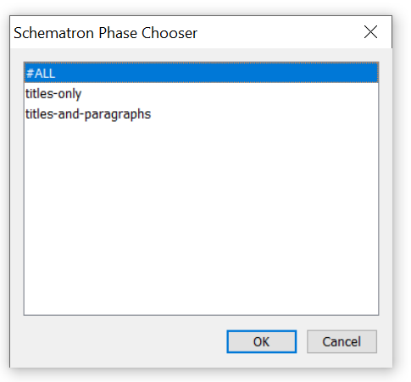
How to select a phase?
Add a default phase with the defaultPhase="…" attribute (on the root element)
oXygen will automatically recognize that there are phases and show a dialog to choose one:
On the command line: -p phase option

Slide 32
Hands-on: Using phases
All files in: …/exercises/exercise-03-02
Read the instructions in: instructions.pdf
Open the files:
Document to validate: input.xml
Template Schematron schema: template.sch
Enhance template.sch according to the instructions
To try it out in oXygen, input.xml is automatically validated by template.sch
Possible solution in: solution/solution.sch (short explanation in solution/explanation.pdf).

Slide 33
Reusing messages: diagnostics
<pattern>
<rule context="…">
<assert test="…" diagnostics="message-1"/>
<assert test="…" diagnostics="message-1"/>
</rule>
</pattern>
<diagnostics>
<diagnostic id="message-1"> (the message…) </diagnostic>
</diagnostics>
Using this mechanism, you can also issue multiple messages!

Slide 34
Hands-on: Reusing messages
All files in: …/exercises/exercise-03-03
Read the instructions in: instructions.pdf
Open the files:
Document to validate: input.xml
Template Schematron schema: template.sch
Enhance template.sch according to the instructions
To try it out in oXygen, input.xml is automatically validated by template.sch
Possible solution in: solution/solution.sch (short explanation in solution/explanation.pdf).

Slide 35


Query Language Binding and using XSLT

Slide 36
Schematron is a container language with a configurable query language for its expressions:
<schema xmlns=http://purl.oclc.org/dsdl/Schematron queryBinding="xslt3">
<let name="department-code" value="/inventory-list/@depcode"/>
<pattern>
<rule context="article">
<assert test="starts-with(@code, $department-code)">
The article code (<value-of select="@code"/>) must start with the right
prefix (<value-of select="$department-code"/>) for <value-of select="name"/>
</assert>
</rule>
</pattern>
</schema>
Query Language Binding or QLB

Slide 37
The queryBinding attribute
Specify the Query Language Binding using the queryBinding attribute on the root element (default value: xslt):
<schema xmlns=http://purl.oclc.org/dsdl/Schematron" queryBinding="…">
…
</schema>
Reserved and defined Query Language Binding names:
exslt
stx
xslt, xslt2, xslt3
xpath, xpath2, xpath3, xpath31
xquery, xquery3, xquery31
Supported Query Language Bindings (by oXygen and SchXslt):
xslt, xslt2, xslt3
Notes:
Some are outdated:
exslt: Allow exslt extension function from exslt.org (last updated: 2003)
stx (Streaming Transformations for XML) an XML based language for transforming XML documents without building a tree in memory (last update: 2007)
Contrary to what you might expect: not case-sensitive

Slide 38
Query Language Binding in practice…
Only for XSLT (and maybe XPath)
Advice:
Use xslt2 or xslt3
Always specify the QLB (using the queryBinding attribute)
Otherwise, you get the default value: xslt
which means XPath 1.0
which is rather limiting…

Slide 39
The xslt2/xslt3 Query Language Binding
Use XPath 2.0 or 3.1 expressions
Use xsl:key to define keys and the key() function for lookups
Add your own XSLT functions with xsl:function and use them in XPath expressions
Officially no other XSLT constructs, like:
xsl:include/xsl:import
xsl:template
Global XSLT variables
But this usually works fine…

Slide 40
Example of using xsl:key
<orders>
<item id="bolts" price="5.49">A box with 20 bolts</item>
<item id="nuts" price="3.78">A box with 20 nuts</item>
<!-- … many, many more items… -->
<order>
<ordered-item id-ref="bolts" quantity="5"/>
<ordered-item id-ref="nuts" quantity="10"/>
</order>
<!-- … many, many more orders… -->
</orders>
<schema xmlns="http://purl.oclc.org/dsdl/schematron"
xmlns:xsl="http://www.w3.org/1999/XSL/Transform" queryBinding="xslt3">
<xsl:key name="item-ids" match="/*/item" use="@id"/>
<pattern>
<rule context="ordered-item">
<assert test="exists(key('item-ids', @id-ref))">
The referenced item <value-of select="@id-ref"/> does not exist
</assert>
</rule>
</pattern>
</schema>

Slide 41
Example of defining a function - 1
<things>
<thing name="thing 1" type="A125" price="17.25"/>
<thing name="thing 2" type="A125" price="17.26"/>
<thing name="thing 3" type="X96" price="89.34"/>
<thing name="thing 4" type="Y78" price="10.01"/>
</things>
<type-codes-and-prices default-price="10.0">
<data type="A125" price="17.25"/>
<data type="X96" price="89.34"/>
</type-codes-and-prices>

Slide 42
Example of defining a function - 2
<schema xmlns="http://purl.oclc.org/dsdl/schematron"
xmlns:xsl="http://www.w3.org/1999/XSL/Transform" queryBinding="xslt3">
<ns uri="#functions" prefix="f"/>
<xsl:function name="f:get-price" as="xs:double">
<xsl:param name="type" as="xs:string"/>
<xsl:variable name="prices-document" as="document-node()"
select="doc('type-codes-and-prices.xml')"/>
<xsl:variable name="data-element-for-type" as="element(data)?"
select="$prices-document//data[@type eq $type]"/>
<xsl:choose>
<xsl:when test="exists($data-element-for-type)">
<xsl:sequence select="xs:double($data-element-for-type/@price)"/>
</xsl:when>
<xsl:otherwise>
<xsl:sequence
select="xs:double($prices-document/type-codes-and-prices/@default-price)"/>
</xsl:otherwise>
</xsl:choose>
</xsl:function>

Slide 43
Example of using a function
<schema xmlns="http://purl.oclc.org/dsdl/schematron"
xmlns:xsl="http://www.w3.org/1999/XSL/Transform" queryBinding="xslt3">
<ns uri="#functions" prefix="f"/>
<xsl:function name="f:get-price" as="xs:double">
…
</xsl:function>
<pattern>
<rule context="thing">
<let name="expected-price" value="f:get-price(@type)"/>
<assert test="$expected-price eq xs:double(@price)">
The price for <value-of select="@name"/> should be
<value-of select="$expected-price"/>
</assert>
</rule>
</pattern>
</schema>

Slide 44
Hands-on: Using XSLT functions
All files in: …/exercises/exercise-04-01
Read the instructions in: instructions.pdf
Open the files:
Document to validate: input.xml
Template Schematron schema: template.sch
Enhance template.sch according to the instructions
To try it out in oXygen, input.xml is automatically validated by template.sch
Possible solution in: solution/solution.sch (short explanation in solution/explanation.pdf).

Slide 45
Wrap-up
Schematron is defined as flexible with regards to its query language
The Query Language Binding or QLB
In practice: xslt (and therefore XPath) only
Set this using the queryBinding attribute. Recommended values:
queryBinding="xslt2"
queryBinding="xslt3"
Allows for XPath 2.0 or 3.1 expressions
XSLT2 and XSLT3 type query bindings also allow XSLT keys and functions
Other XSLT features are officially unsupported but usually work

Slide 46

Wrap up
Schematron is a simple but powerful XML based validation language
It consists mainly of patterns, rules, asserts and reports
Messages can be tailored to your (or the user's) needs
It has mechanisms for re-use of code, among which abstract patterns
It can incorporate XSLT keys and functions (and, unofficially, more)
But there is much more to explore!

Slide 47
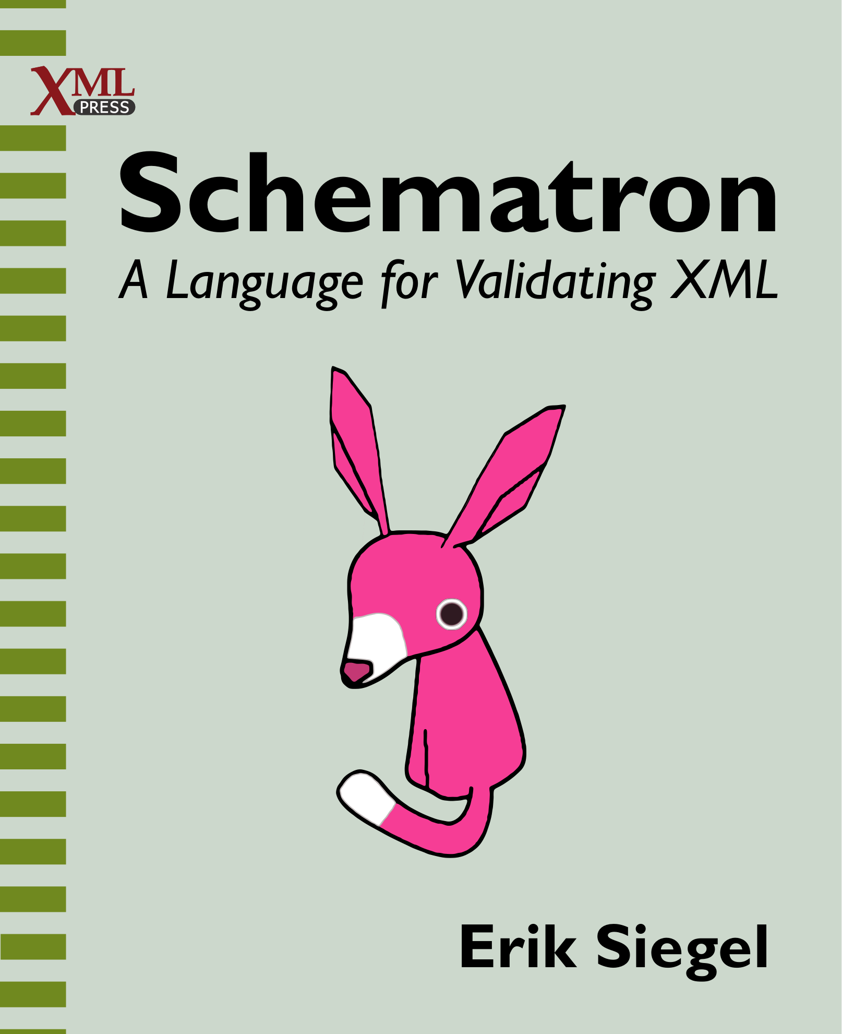
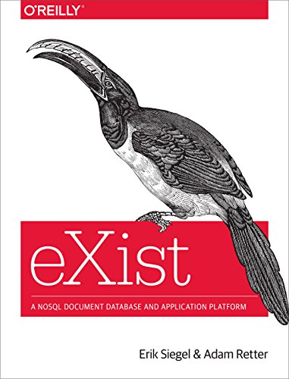
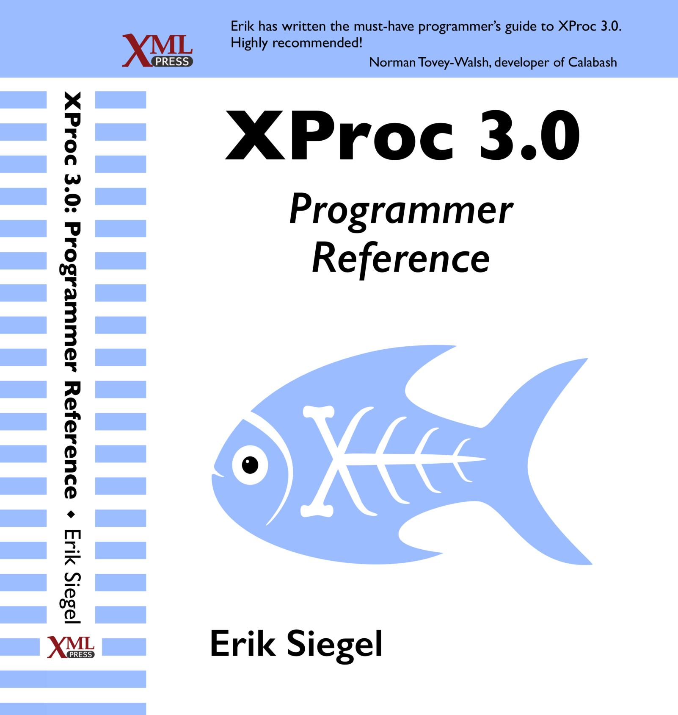
Introductions
Schematron in context (of other validation languages)
How to apply Schematron (with SchXslt, in Oxygen, etc.)
Basics (patterns, rules, asserts/reports, value-of, variables, namespaces)
Advanced (diagnostics, phases, abstract rules/patterns, includes)
Query Language Binding
Additional features (markup, flags, roles, etc.)
Some further examples and recipes
Appendices:
XPath technology primer
Introduction to namespaces
Schematron & SVRL reference
Introduction to SQF
Additional reading
My other books
https://xmlpress.net/publications/schematron/

Slide 48

Questions?
Erik Siegel
www.xatapult.com
erik@xatapult.nl

